Slide 1
Dutch Lady - IFT
MMM: EDA and Model Insights

Slide 2
MARKET PICTURE

Slide 3
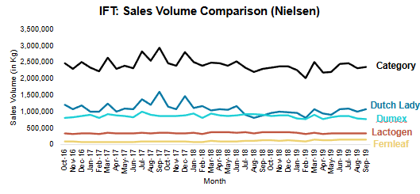
IFT: Sales Volume (Nielsen) Peninsular Malaysia
Sales Volume (in Kilotones)
Brands | Oct '16 - Sep'17 | Oct '17 - Sep'18 | Oct '18 - Sep'19 | CAGR (Oct '16 - Sep'19)
Dutch Lady | 14.05 | 12.93 | 11.94 | -7.82%
Dumex | 10.53 | 10.72 | 10.05 | -2.3%
Lactogen | 4.13 | 4.35 | 4.20 | 0.83%
Fernleaf | 1.09 | 1.27 | 1.66 | 23.34%
Category | 29.81 | 29.27 | 27.85 | -3.33%
Inferences
Dutch Lady is the market leader in IFT category
Dutch Lady IFT shows downward trend in sales volume. Sales have fallen approximately 8% from Oct‘16 to Sept’19
Dumex, the second largest player in the IFT category has also shown negative growth.
Category Sales also show a downward trend in the same period (~3%)
Fernleaf shows a substantial growth in sales volume (on a low base)

Slide 4
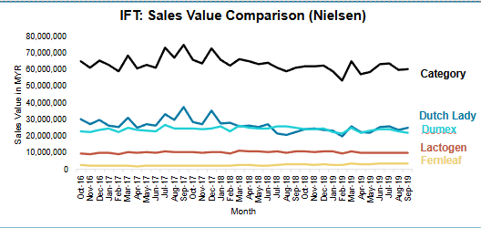
IFT: Sales Value (Nielsen) Peninsular Malaysia
Sales Value (in Mn MYR)
Brands | Oct '16 - Sep'17 | Oct '17 - Sep'18 | Oct '18 - Sep'19 | CAGR (Oct '16 - Sep'19)
Dutch Lady | 349.24 | 315.79 | 285.73 | -9.55%
Dumex | 287.11 | 299.48 | 280.29 | -1.2%
Lactogen | 120.07 | 125.58 | 122.90 | 1.17%
Fernleaf | 26.57 | 30.17 | 38.07 | 19.71%
Category | 782.98 | 771.01 | 727.00 | -3.64%
Inferences
Dutch Lady – IFT Sales value shows negative growth of (~ 10%)
Dumex , the second largest player in the category has also experienced a negative growth (1.2%)
Category Sales Value also shows negative growth (~4%)

Slide 5
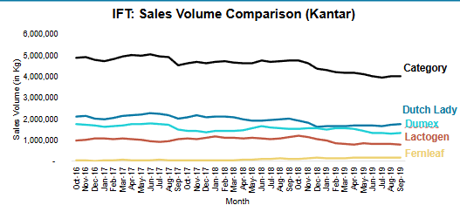
IFT: Sales Volume (Kantar) Peninsular Malaysia
Sales Volume (in Kilotones) (time period – rolling 12 week)
Brands | Oct '16 - Sep'17 | Oct '17 - Sep'18 | Oct '18 - Sep'19 | CAGR (Oct '16 - Sep'19)
Dutch Lady | 25.42 | 24.29 | 20.45 | -10.30%
Dumex | 20.32 | 17.85 | 17.47 | -7.27%
Lactogen | 12.12 | 13.08 | 10.81 | -5.56%
Fernleaf | 0.56 | 0.84 | 1.86 | 81.78%
Category | 58.42 | 56.07 | 56.07 | -6.94%
Inferences
Dutch Lady IFT sales volume shows negative trend as per Kantar. Volume sales fall ~ 10% from Oct’16 to Sep’19
Dumex and Lactogen also show a downward trend in sales volume
Overall, category sales volume show a downward trend (~7%) as sales of major brands are falling
Fernleaf shows a significant increase in sales (on a low base)

Slide 6
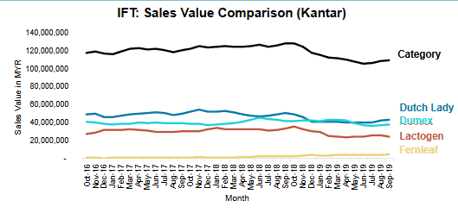
IFT: Sales Value (Kantar) Peninsular Malaysia
Sales Value (in Mn MYR) (time period-rolling 12 weekly)
Brands | Oct '16 - Sep'17 | Oct '17 - Sep'18 | Oct '18 - Sep'19 | CAGR (Oct '16 - Sep'19)
Dutch Lady | 587.4 | 606.1 | 503.4 | -7.42%
Dumex | 471.2 | 487.9 | 482.6 | 1.20%
Lactogen | 364.2 | 385.5 | 325.5 | -5.47%
Fernleaf | 12.4 | 19.4 | 44.3 | 88.81%
Category | 1435.2 | 1498.8 | 1355.8 | -2.81%
Inferences
Dutch Lady IFT Sales value drops by ~7% from Oct ‘16 to Sep ‘19
Fernleaf sales value shows significant increase in the same period
Category sales value declining by ~3%

Slide 7
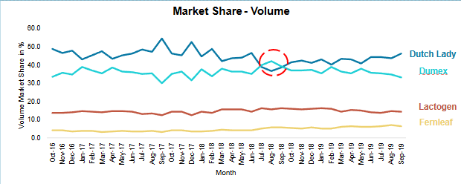
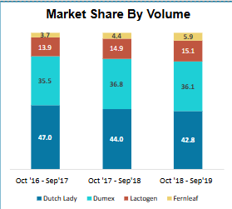
IFT: Market Share by Volume (Nielsen)
Inferences
Dutch Lady IFT market share dropped from 47% to 42.8% while competitors have gained in volume market share in the same period :
Dumex market share increased slightly from 35.5% to 36.1%
Lactogen market share increased from 13.9 % to 15.1 %
Fernleaf market shared increased from 3.7 % to 5.9%
It is to be noted that DL- IFT Market share dropped lower than Dumex between Jul’18 and Sep’18 ( as highlighted in red circle)

Slide 8
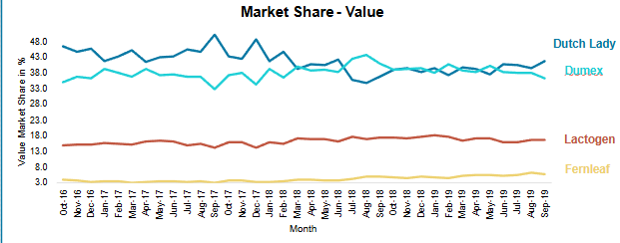
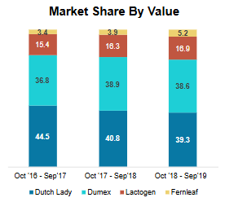
IFT: Market Share by Value (Nielsen)
Inferences
Dutch Lady IFT value market share dropped from 44.5% to 39.3%. while competitors have gained in value market share as well in the same period :
Dumex value market shared increased from 36.8 % to 38.6%
Lactogen value market shared increased from 15.4 % to 16.9%
Fernleaf value market shared increased from 3.4 % to 5.2%

Slide 9
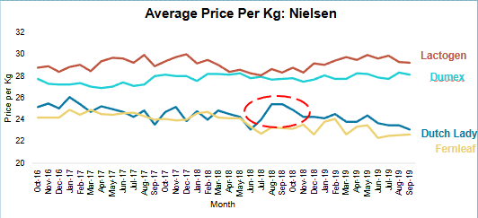
IFT: Price Comparison (Nielsen)
Inferences
Dutch Lady shows more drastic price increases as compared to competitors especially in the period of (July- Aug)
It is also observed that in the recent months, Dutch Lady’s price point is the lowest relative to its own historic pricing.
Dutch Lady and Fernleaf have almost the same price-points whereas Lactogen and Dumex have similar price points (slightly higher than the former two)

Slide 10
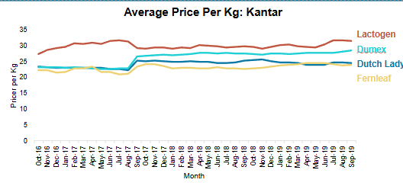
IFT: Price Comparison (Kantar)

Slide 11
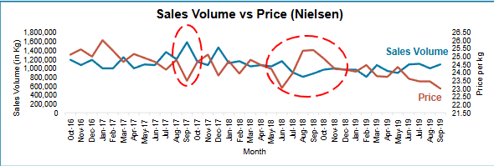
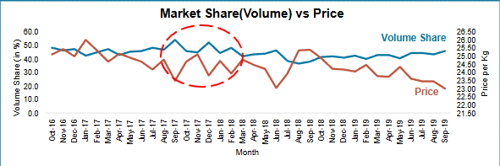
Dutch Lady IFT: Sales vs price and Market Share vs Price
Inferences
The “Diamond phenomenon” is indicative of the price sensitivity
Many diamond shapes (highlighted by red oval) could be observed between the trend line of sales and price, Market share and price, respectively.
Whenever there is a price increase, both sales and market share have dropped considerably. Similarly any price decline has led to recovery in both sales and market share

Slide 12
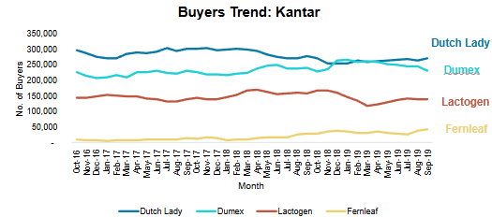
IFT: Buyers Comparison
Brands | Oct '16 - Sep'17 | Oct '17 - Sep'18 | Oct '18 - Sep'19 | CAGR (Oct '16 - Sep'19)
Dutch Lady | 34,54,359 | 34,70,930 | 31,49,481 | -4.51%
Dumex | 26,42,735 | 27,76,268 | 29,96,314 | 6.48%
Lactogen | 17,24,273 | 18,56,321 | 17,04,880 | -0.56%
Fernleaf | 1,10,421 | 1,97,050 | 4,12,460 | 93.27%
Inferences
Dutch Lady – IFT buyers declining by 4.51%. But in recent months (April 2019- Sep 2019) there seems to be significant recovery.
Dumex buyers are increasing from Oct’16 to Sep’19 (6.5%)
Fernleaf shows a significant increase in no. of buyers

Slide 13
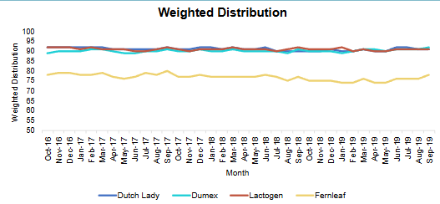
IFT: Weighted Distribution Comparison (Nielsen)
Brands | Oct '16 - Sep'17 | Oct '17 - Sep'18 | Oct '18 - Sep'19 | CAGR (Oct '16 - Sep'19)
Dutch Lady | 91.6 | 91.1 | 90.7 | -0.50%
Dumex | 90.0 | 90.2 | 90.5 | 0.28%
Lactogen | 91.3 | 91.0 | 90.8 | -0.23%
Fernleaf | 78.2 | 77.0 | 75.3 | -1.88%
Inferences
Weighted Distribution for all brands almost remained same throughout the period

Slide 14
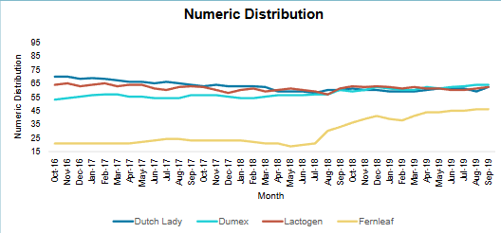
IFT: Numeric Distribution Comparison (Nielsen)
Brands | Oct '16 - Sep'17 | Oct '17 - Sep'18 | Oct '18 - Sep'19 | CAGR (Oct '16 - Sep'19)
Dutch Lady | 67.0 | 61.1 | 60.2 | -5.24%
Dumex | 55.0 | 56.0 | 61.5 | 5.74%
Lactogen | 63.2 | 59.8 | 61.5 | -1.33%
Fernleaf | 21.9 | 23.3 | 42.0 | 38.43%
Inferences
Dutch Lady-IFT: Numeric Distribution showed a decline of 5% where as Dumex showed an increase by similar amount
Fernleaf Numeric Distribution grew substantially from 21.9 to 42.0 (albeit on a low base)

Slide 15
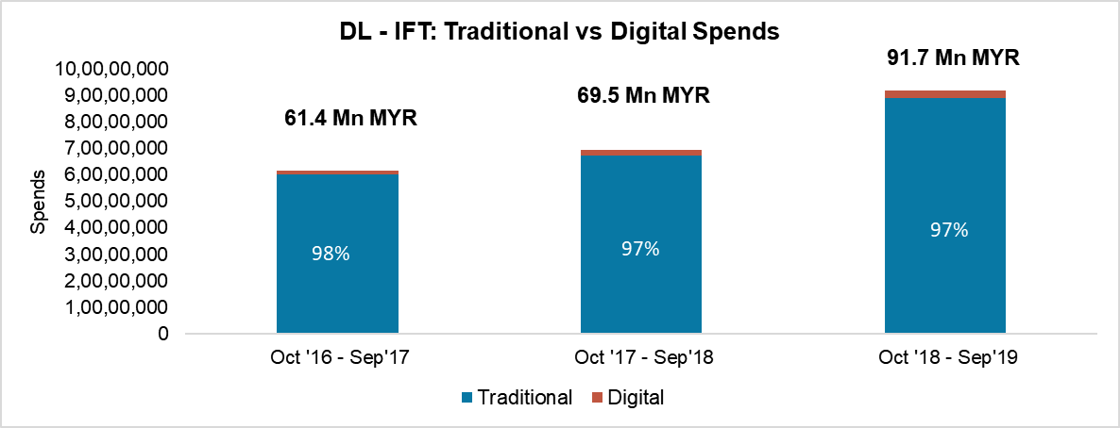
Dutch Lady IFT: Media Analysis Traditional vs Digital Investment
Months | Traditional | Digital | Total
Oct '16 - Sep'17 | 6,02,13,629 | 12,01,656 | 6,14,15,285
Oct '17 - Sep'18 | 6,73,15,228 | 21,74,124 | 6,94,89,352
Oct '18 - Sep'19 | 8,88,81,613 | 27,91,430 | 9,16,73,044
Inferences
Media Spends have increased by 22% from Year 1 (61.4 Mn MYR) to Year 3 (91.7 Mn MYR)
However, the split between Traditional and Digital spends remained more or less the same

Slide 16
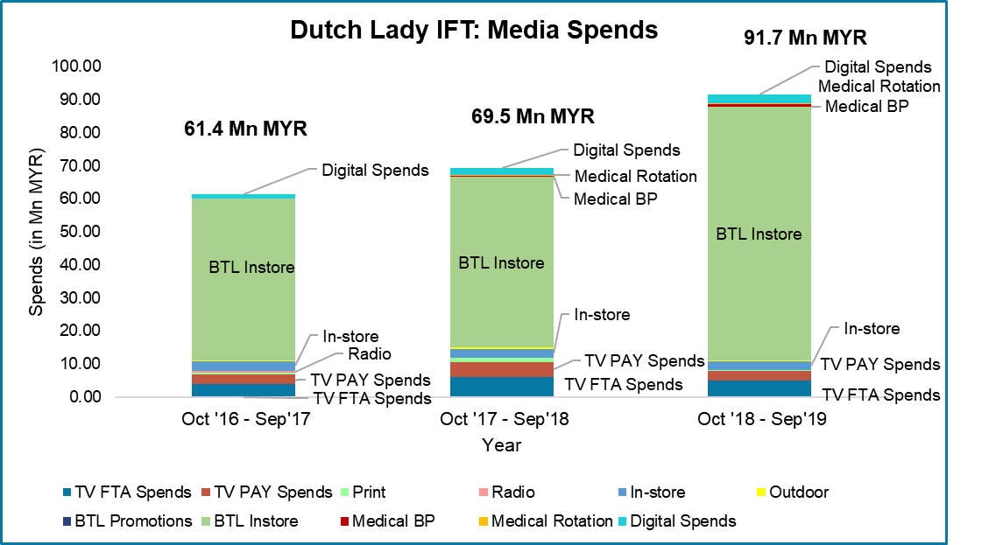
Marketing Investment: Spends split
Inferences
BTL Instore spends constituted 80% (every year) of the total marketing spends
TV FTA and TV PAY constituted 7% and 5% (every year) of the total marketing budget respectively

Slide 17
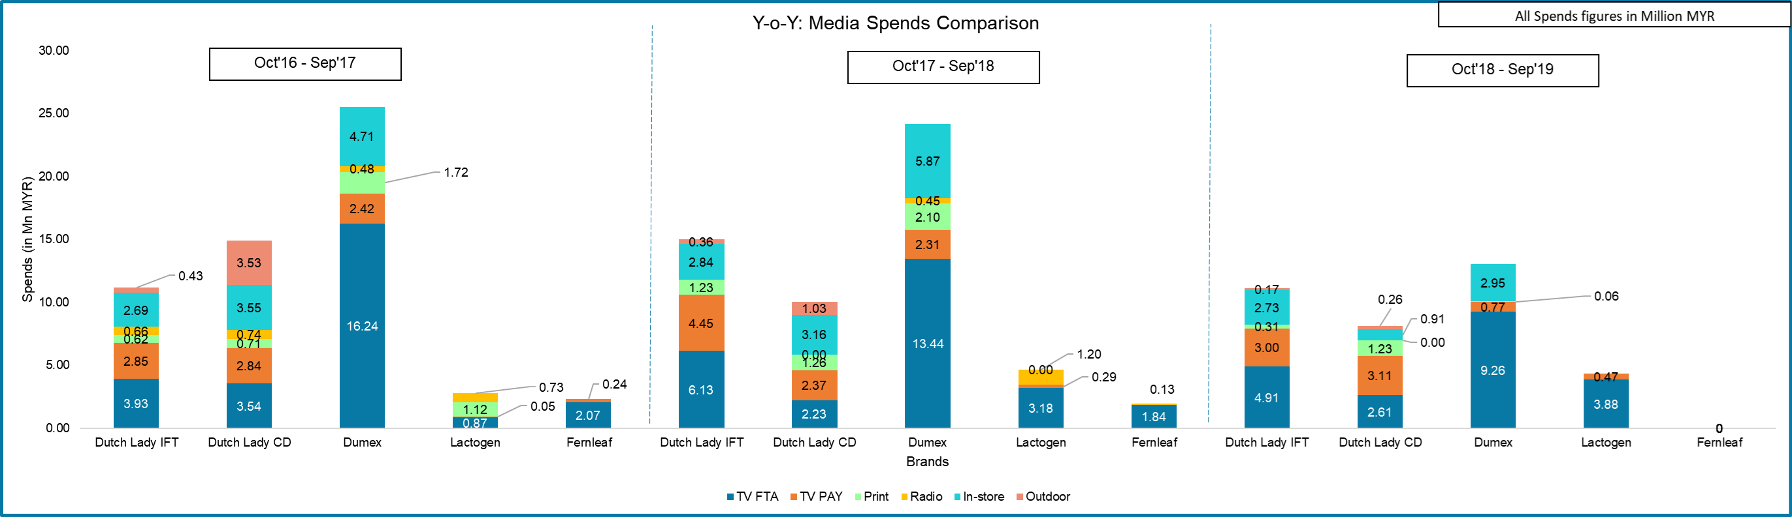
Media Strategy Analysis
Inferences
Year 1 : Dumex had spent more than double of Dutch Lady IFT in Year 1 in marketing budget
Dumex spent 4 times of DL-IFT in TV FTA
Lactogen and Fernleaf being low market share players were spending less than DL-IFT
Year 3: It is to be noted that the gap between Dutch Lady-IFT and Dumex spending has largely reduced owing to tremendous marketing spend cut by Dumex
Note: The analysis doesn’t include BTL promotions and Medical marketing investments as BTL and medical data are not available for competitors

Slide 18
DRIVERS OF SALES

Slide 19
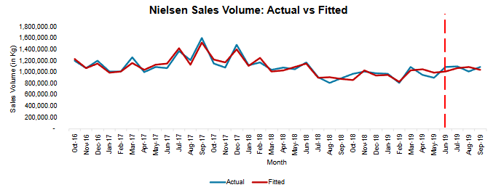
Dutch Lady IFT: Sales – Model Accuracy
Model Statistics
In sample MAPE period (Oct 2016 – June 2019)
Out sample MAPE period (Oct 2016 – June 2019)
In Sample MAPE: 4.71%
Out Sample MAPE: 5.07%
R-Squared: 86.80%
Adjusted R-Squared: 78.9%
Inferences
The model was found to be robust on all metrics. The near perfect fit of the predicted line vs the Actual is proof of that.
In sample and out sample MAPE of 4.7 % and 5.1% respectively are considered good and very much acceptable by industry standards

Slide 20
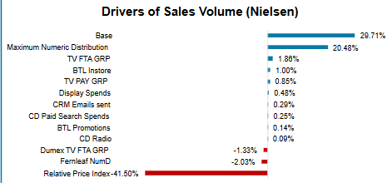
What drives Sales Volume?
How to interpret
Suppose 100 units are sold, out of that 30 units are contributed by Baseline sales (Brand equity), 21 units are contributed by distribution and 2 units are contributed by TV
Similarly, 42 units are taken away due to price increase and 1.3 units due to Dumex TV FTA GRP impact
Inferences
Brand Equity and Distribution contribute to 50 % of sales
Price takes away 41% of the sales assuming there are 100 units.
It is to be noted that it doesn’t mean that the sales are falling by 41%. It indicates how much impact price changes have on sales volume as compared to other marketing factors (the diamond phenomenon covered in earlier slides)
TV FTA and TV PAY contribute 3% to sales
BTL Instore contributes only 1% to sales although it constitutes 80% of the total marketing spends
Other factors contributing to sales include Display spends, CRM Emails sent, BTL promotions CD Paid search(Halo) and CD Radio(Halo). However the impact remains relatively low
Dumex FTA GRP and Fernleaf Distribution take away sales from Dutch Lady-IFT

Slide 21
Return on Investment: Sales
Marketing Inputs | ROI
BTL Promotions | 157.6
BTL Instore | 0.6
TV FTA GRP | 11.0
TV PAY GRP | 7.3
Display Spends | 85.5
Dutch Lady CD Radio | 10.5
Dutch Lady CD Paid Search Spends | 333.6
Inferences
While the highest spends were observed on BTL Instore, it seems that it gives the lowest ROI (0.6)
TV FTA and TV PAY give decent ROIs of 11 and 7.3 respectively
Display Spends too seem to be yield good ROI
Dutch Lady CD Paid search spend seems to yield the highest ROI

Slide 22
DRIVERS OF BUYERS

Slide 23
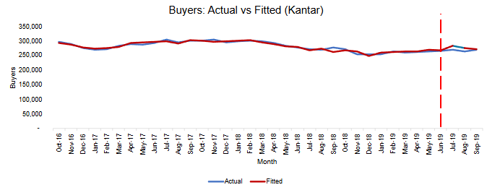
Dutch Lady IFT: Buyers– Model Accuracy
Model Statistics
In sample MAPE period (Oct 2016 – June 2019)
Out sample MAPE period (Oct 2016 – June 2019)
In Sample MAPE: 1.47%
Out Sample MAPE: 3.41%
R-Squared: 90.4%
Adjusted R-Squared: 87.8%
Inferences
The model seemed to be overfitted.
In sample and out sample MAPE of 1.5 % and 3.4% respectively are indicative of overfitting

Slide 24
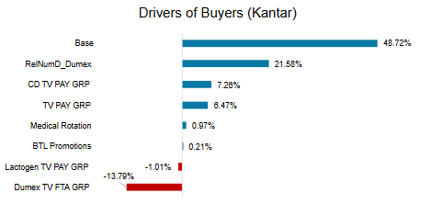
What drives Buyer growth?
How to interpret
Suppose 100 units are sold, out of that 49 units are contributed by Baseline sales (Brand equity), 22 units are contributed by distribution and 6 units are contributed by TV PAY and 7 units by Dutch Lady- CD (Halo)
Similarly, 18 units are taken away due to Dumex TV FTA GRP impact and 1 unit by Lactogen TV PAY GRP
Inferences
Brand Equity and Distribution contribute to 70 % of number of Buyers
TV TV PAY contribute 6.5% to sales
Halo impact of Dutch Lady CD TV PAY is also observed (7%)
Other factors contributing to sales are medical rotation and BTL promotions
Dumex FTA GRP and Lactogen PAY GRP take away Buyers from Dutch Lady-IFT

Slide 25
Which model to pursue ?
Nielsen Sales Volume model seems to capture the market reality more efficiently than the Buyer model
The sales model was able to capture the impact of key marketing inputs: BTL Instore, TV and Price
While the buyer model could not capture these impacts
Also from a statistical point of view, the Buyer model seemed to overfit thus disqualifying it from any attribution and predictive purposes
Hence, it is advisable to pursue Nielsen Sales volume model

Slide 26
THANK YOU

